Slide 1


Optimizing Target Store Locations in Indiana: A GIS-Based Data-Driven Analysis for Strategic Site Selection

Slide 2

Introduction to Target Location Analysis
Objective:
Identify potential new Target store locations to maximize foot traffic and increase sales.
Need for Analysis:
Target has a strong retail presence, but expanding to strategic new locations can drive further growth.
Understanding consumer behavior, market demand, and demographic factors is essential to choosing optimal locations for new stores.
Why This Matters:
By analyzing factors such as household income, foot traffic, and product demand, we can pinpoint areas where Target can thrive.
This analysis provides insights to help maximize revenue and improve the customer shopping experience.
Tools Used:
ArcGIS ,PowerBI and Excel

Slide 3
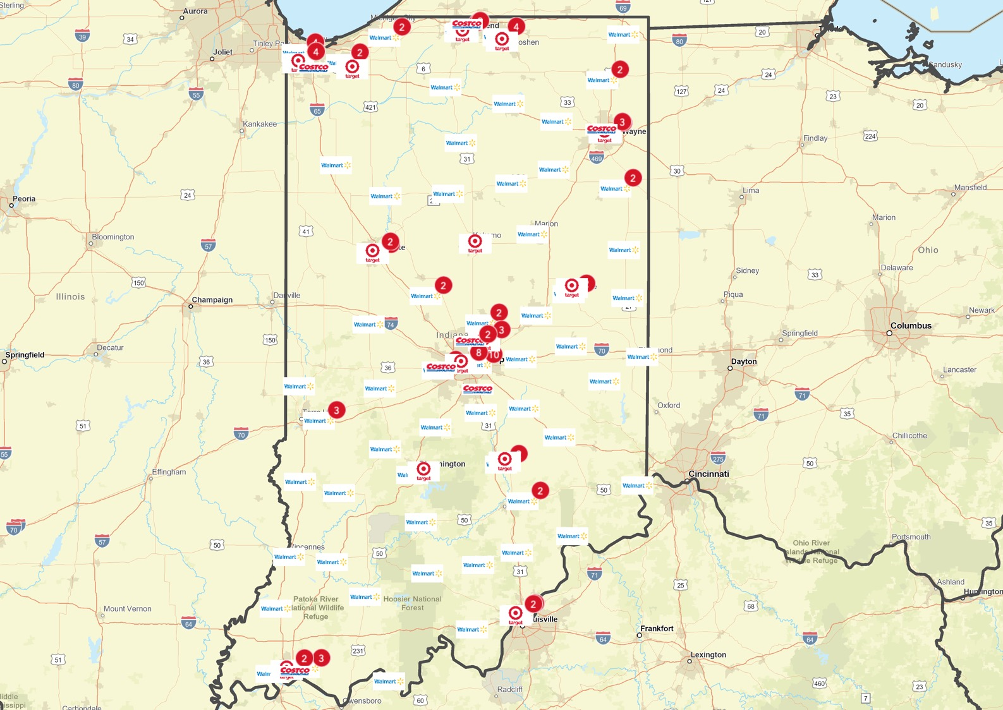
Geographical locations of Walmart, Target and Costco in Indiana

Slide 4
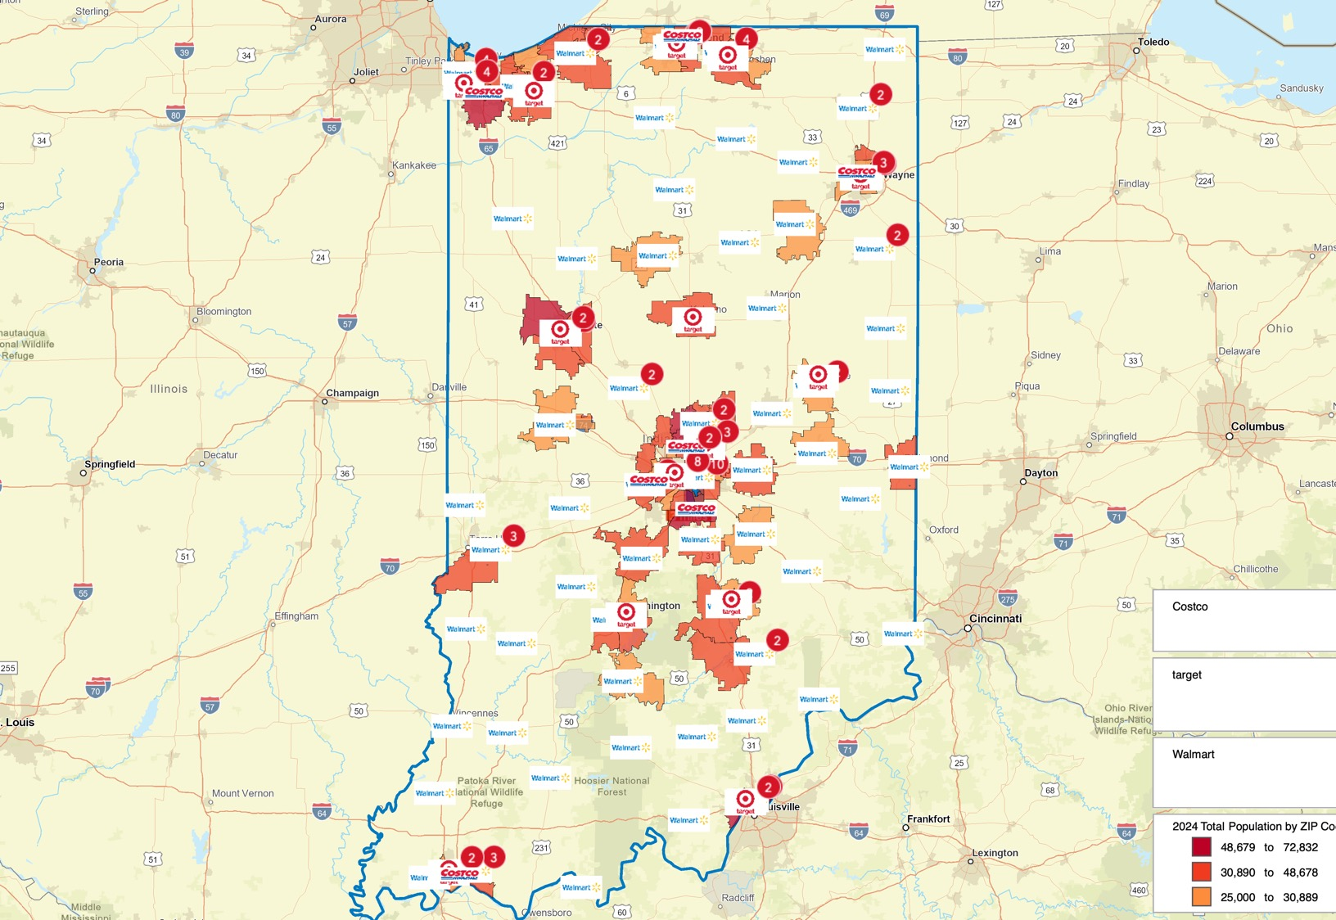
Color coding areas which has population higher than 25,000.

Slide 5
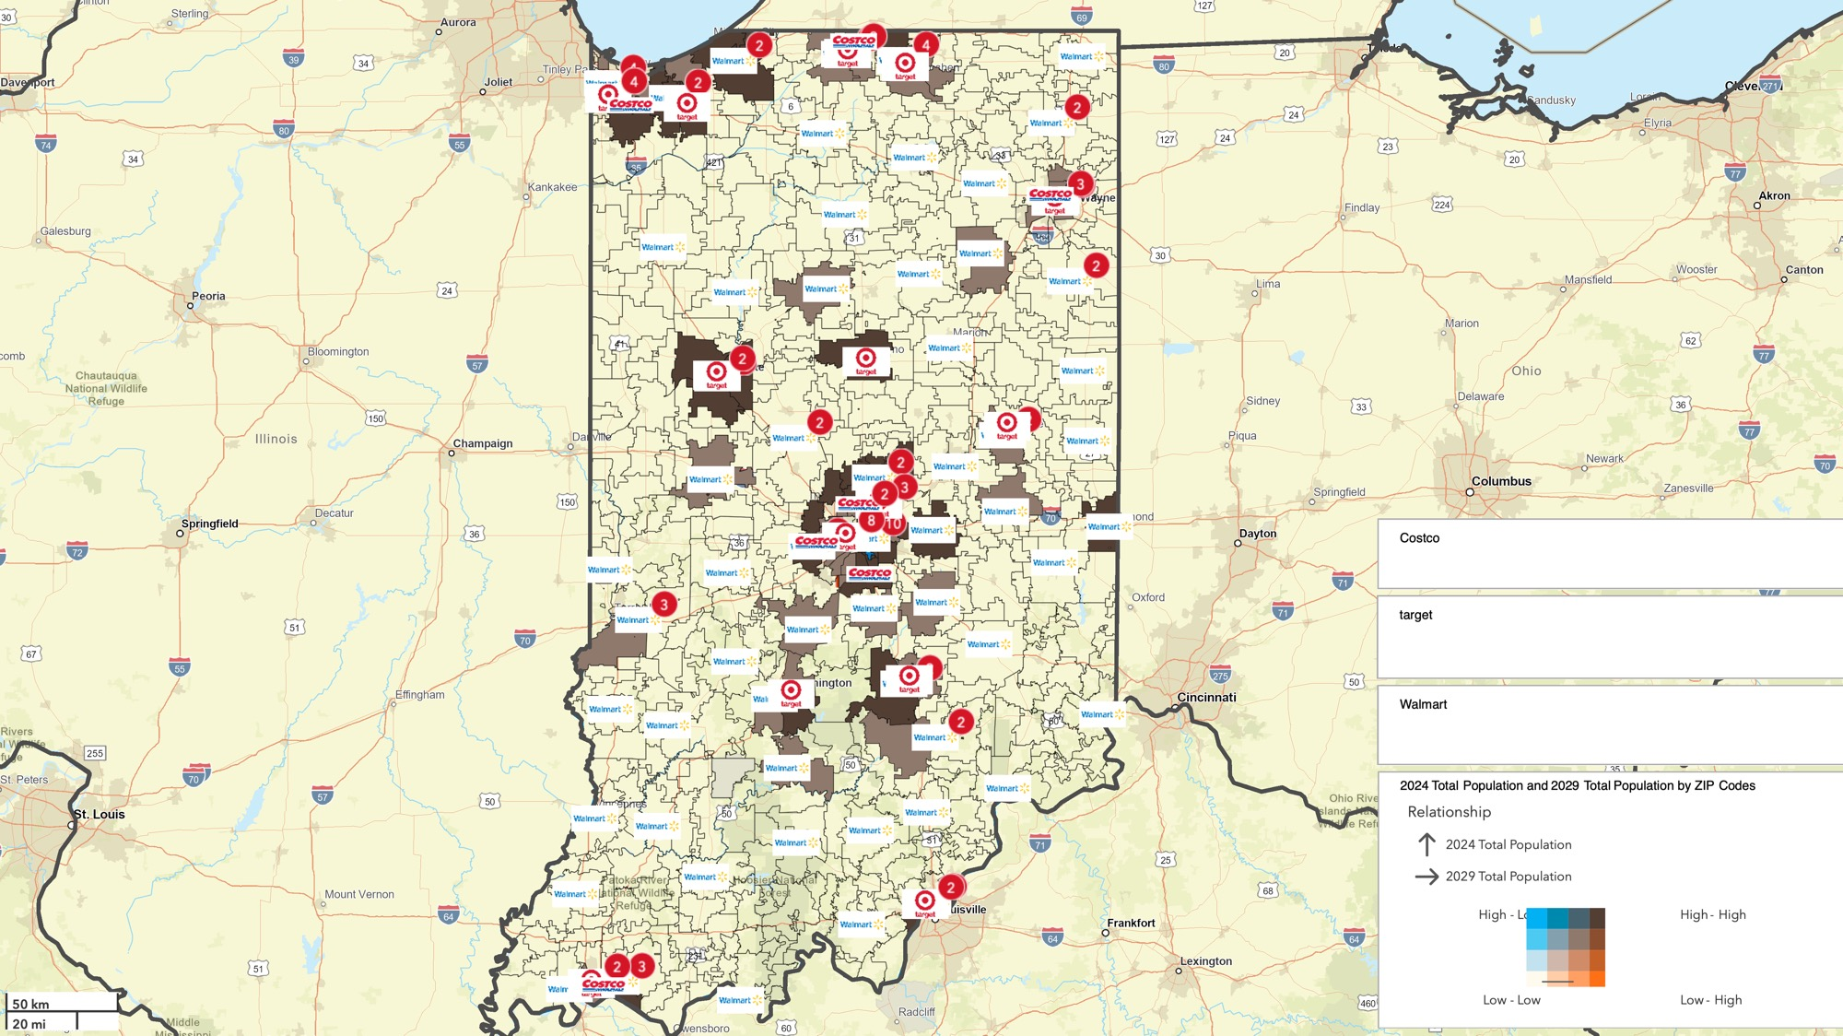
Relationship with current and 2029 expected population

Slide 6
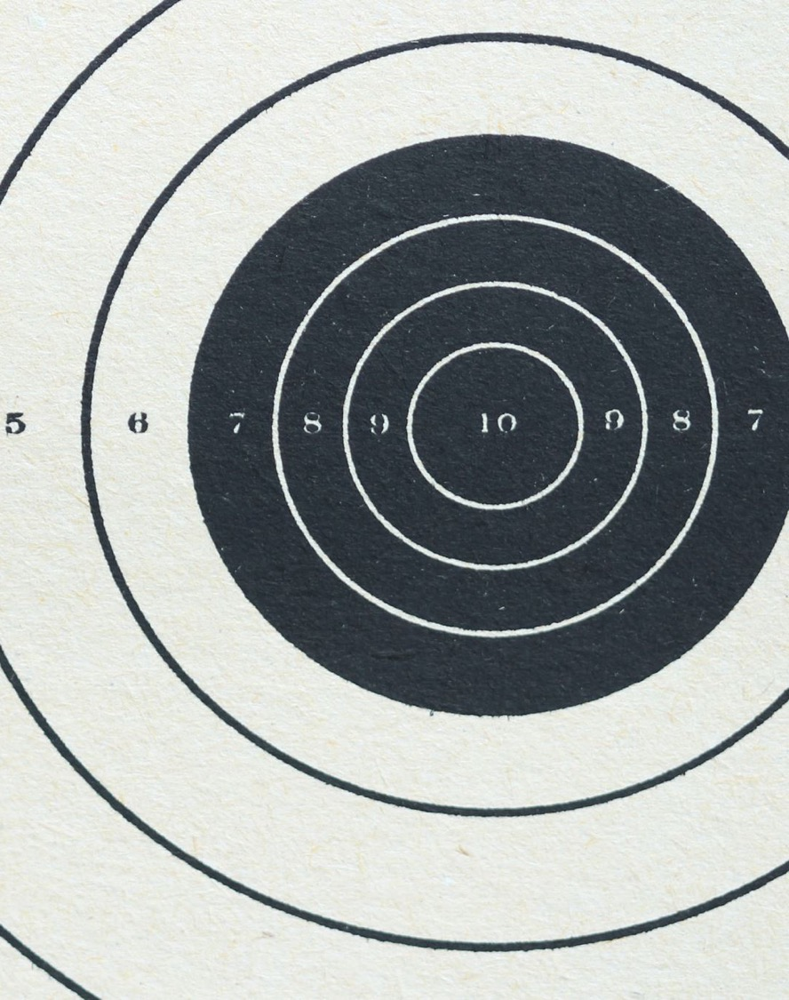
Identifying Target hotspots based on population
Criteria used for the hotspots
Population within the 3-mile radius higher than 25,000.
Priority HIGH – for spots where there is no Walmart within 3mile radius.
No target location near-by

Slide 7
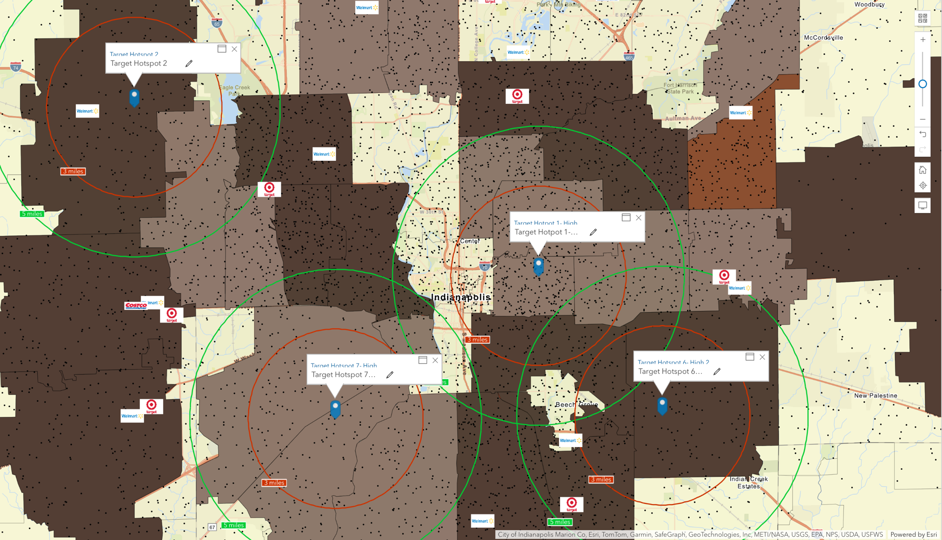

Slide 8
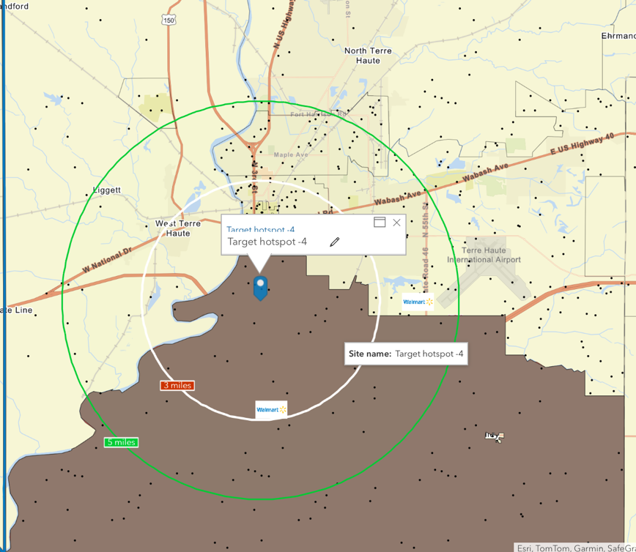
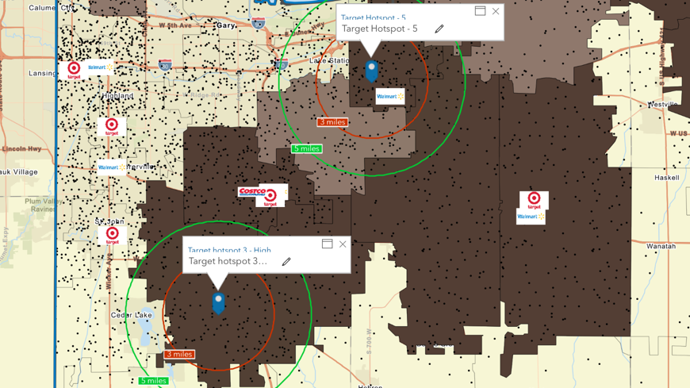

Slide 9

Analyzing demographics in the hotspot areas

Slide 10
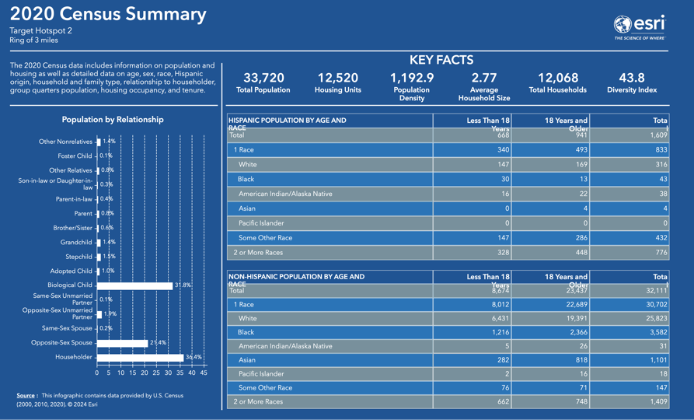
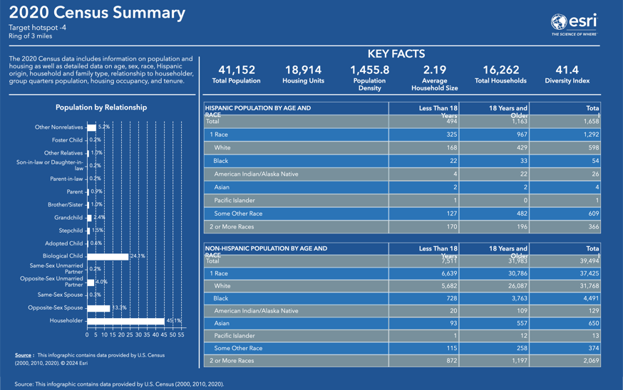
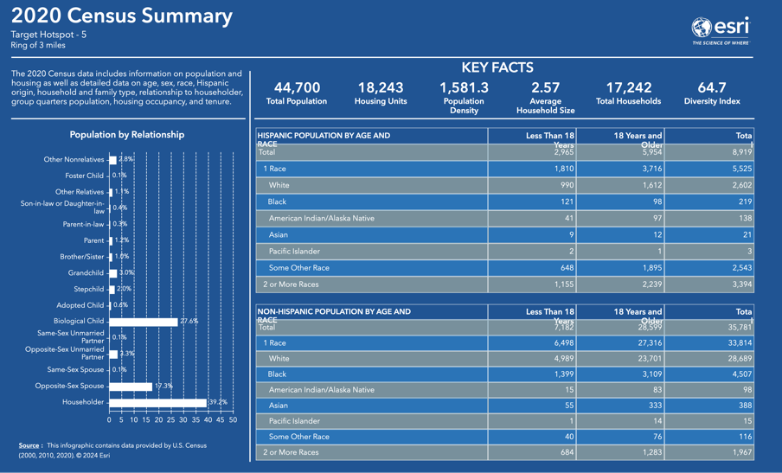
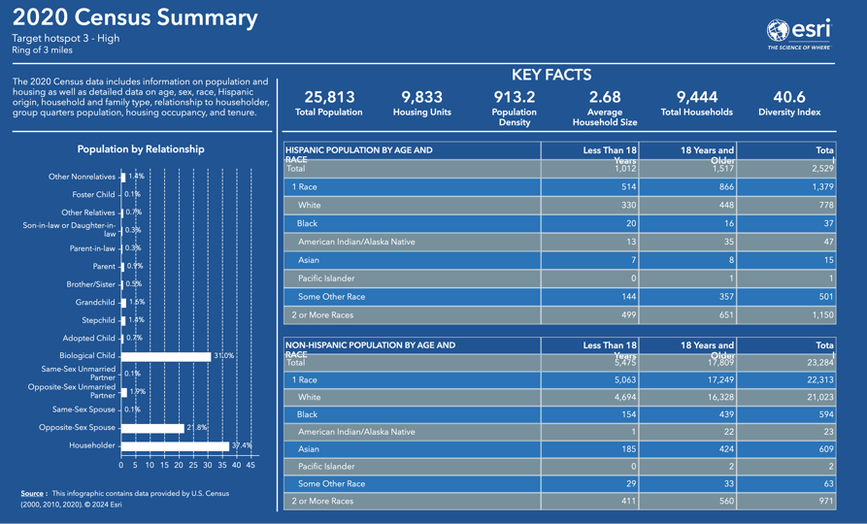

Slide 11
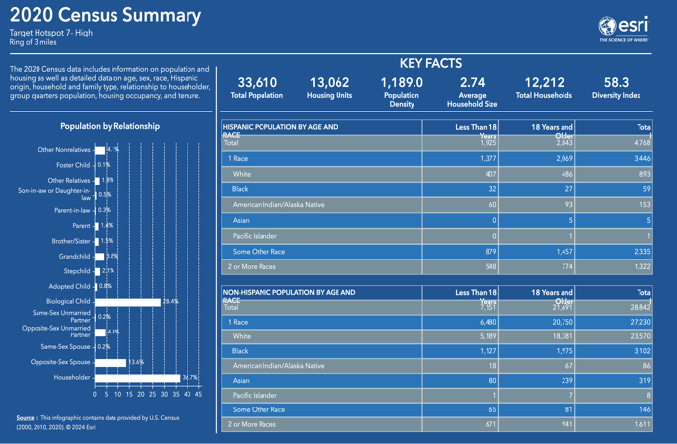
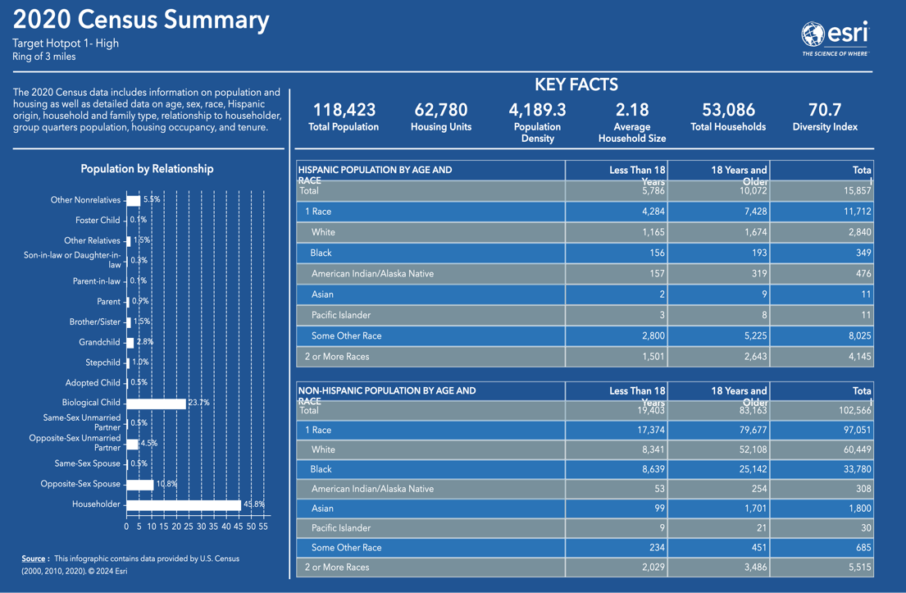


Slide 12

Deepen Demographic Analysis to Refine and Validate Selected Hotspots

Slide 13
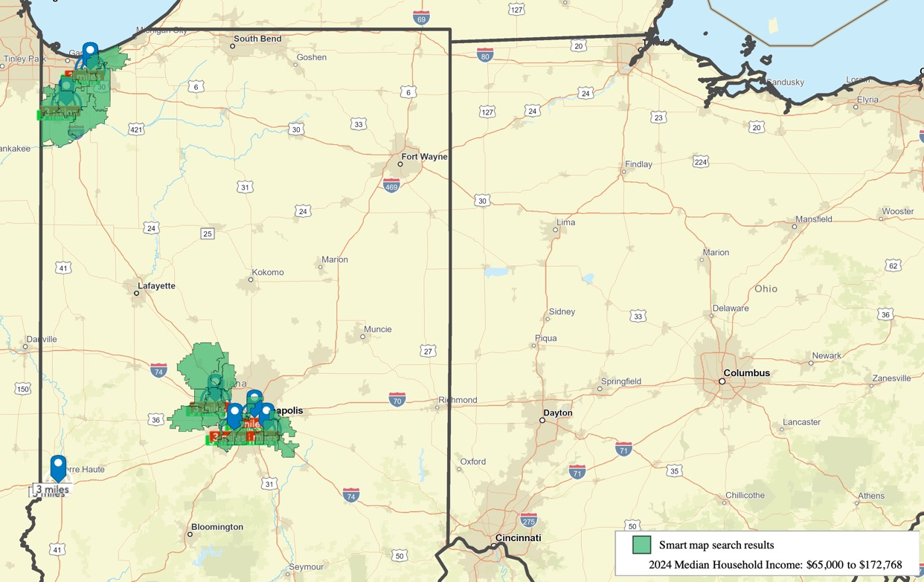
Medium Household income greater than $65,000
Verification of Hotspot Locations exceeding $65,000, aligning with our income threshold.
Exclusion of Terre Haute Hotspot as it does not satisfy the median household income.

Slide 14
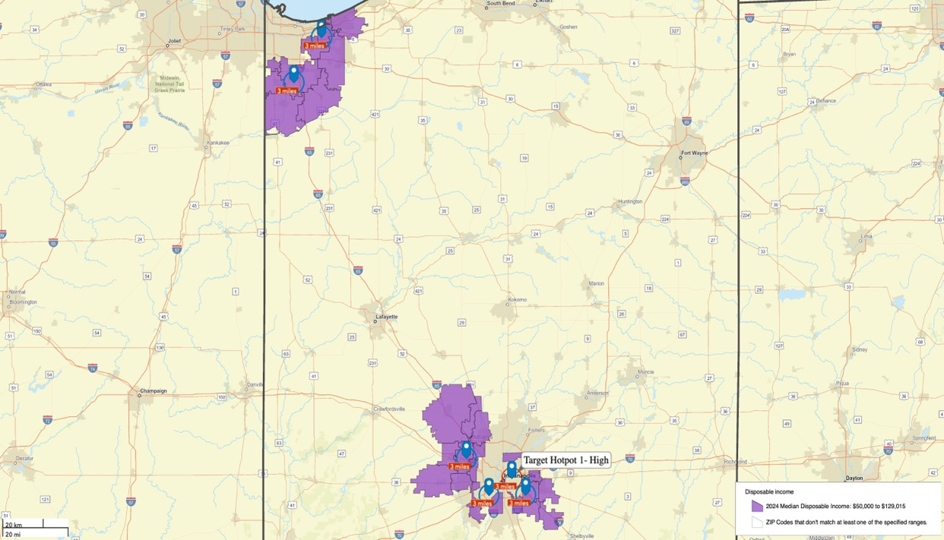
Medium Household disposable income greater than $50,000
Validation of Hotspot Locations where the disposable income exceeds $50,000.
Exclusion of Target Hotspot-1 as it does not meet the medium disposable household income criteria.

Slide 15
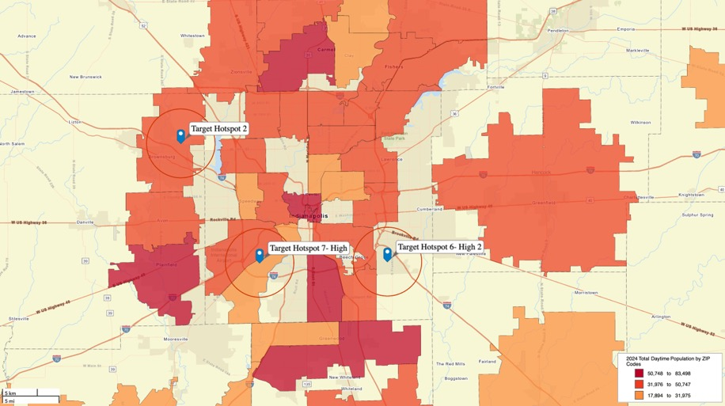
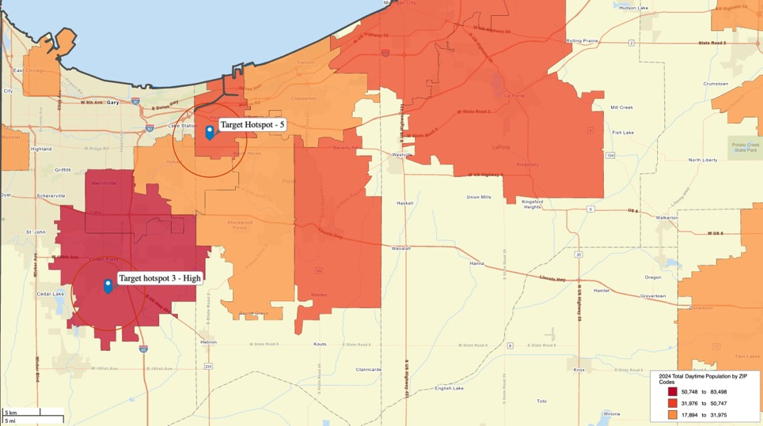
Daytime population over 25,000
Exclusion of Target Hotspot-6 Due to Foot Traffic Below 25,000

Slide 16

Market Analysis

Slide 17
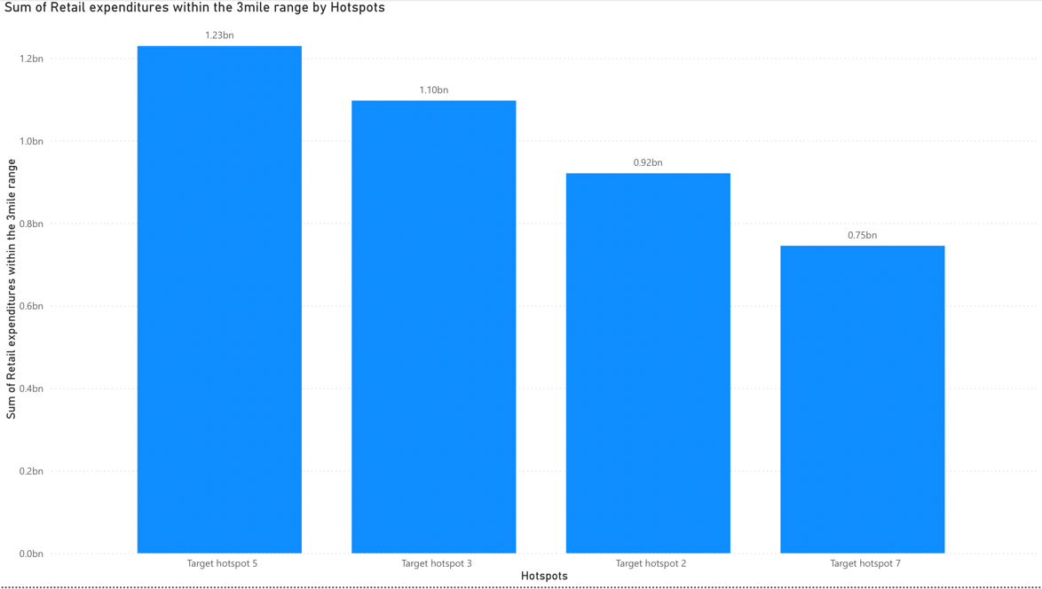
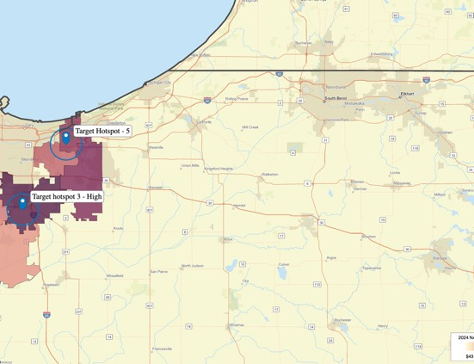
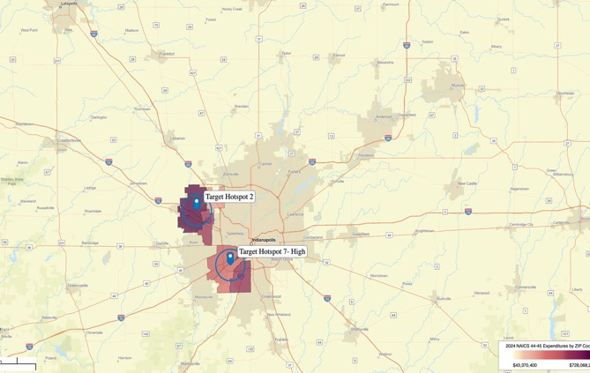
Retail Demand Analysis within 3miles of Identified Hotspot Areas
This analysis enables us to assess the potential retail demand within these hotspot areas.
Note: The Power BI visualization is generated by exporting ESRI data to Excel, followed by pivoting the data based on the identified hotspots.

Slide 18
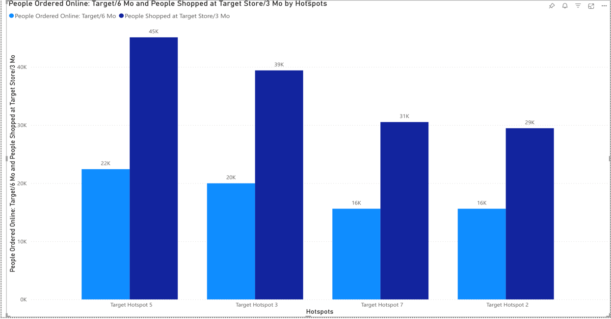
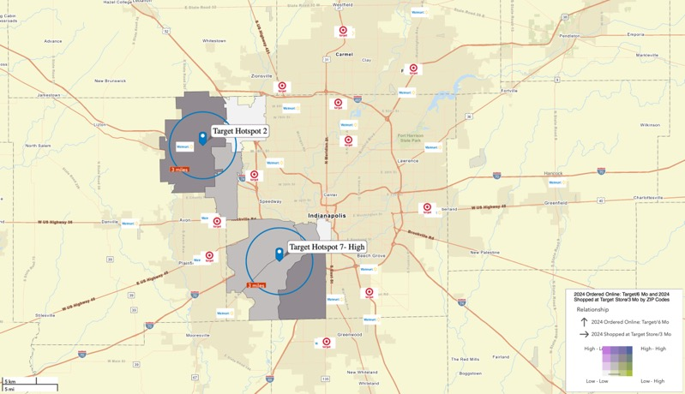
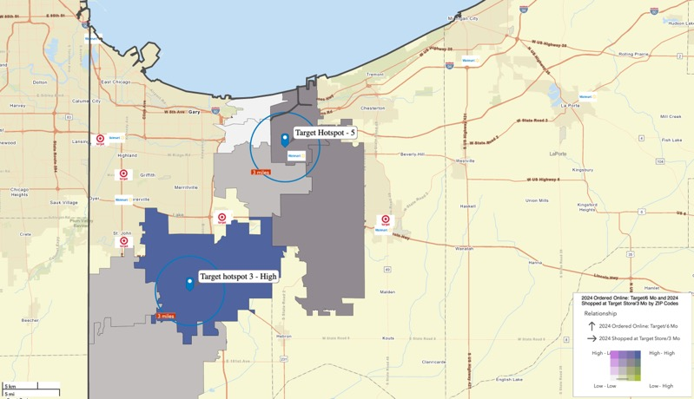
People shopped at Target Online in 6 months vs Target stores in past 3 months
Analysis revealed strong demand for Target shopping, even in areas without nearby locations.
With in-store customers doubling online shoppers within 3 months, establishing new Target locations in these areas presents a significant opportunity to capitalize on existing demand and drive further foot traffic growth.
Note: The Power BI visualization is generated by exporting ESRI data to Excel, followed by pivoting the data based on the identified hotspots.

Slide 19
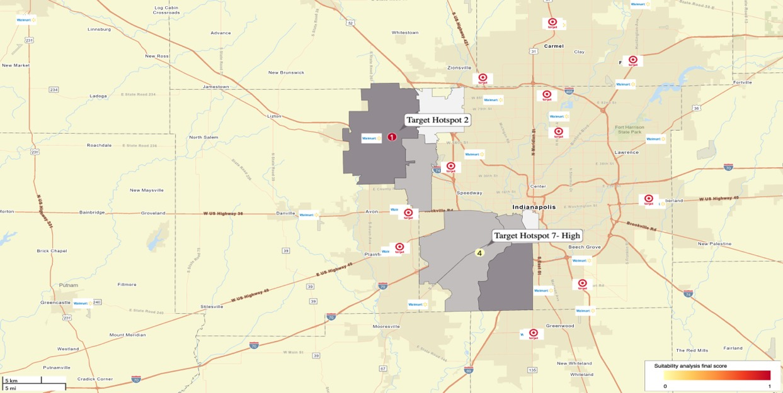
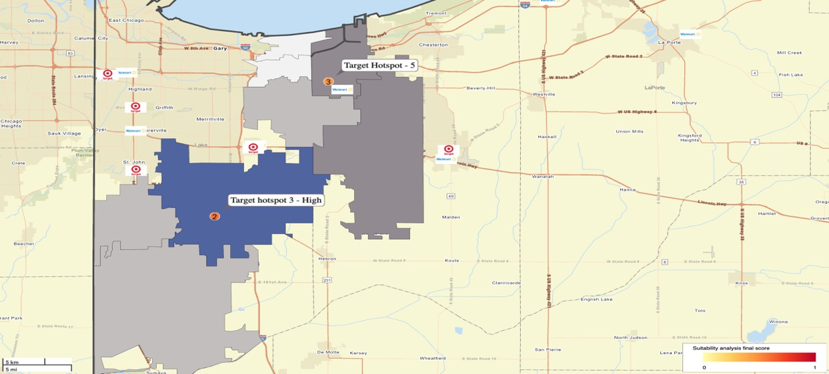
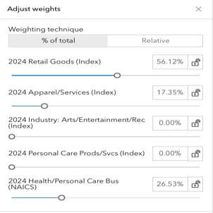
Leverage Product Category Sales Distribution to Rank and Shortlist Top 2 Locations
Analyzing the sales distribution across key product categories (Apparel, Food, Decor, Hardlines, Beauty) to identify locations where demand aligns with store strengths, allowing for strategic ranking.
Adjusted weights according to Targets market Share

Slide 20

Conclusion
Based on our comprehensive analysis, Target Hotspot 2 in Brownsburg and Target Hotspot 3 in Crown Point, Indiana, have emerged as the top two potential locations for new Target stores.
With Brownsburg ranking first and Crown Point securing the second position, these areas demonstrate significant market demand and alignment with Target's strategic goals, positioning Target to capture increased foot traffic and sales opportunities in these thriving communities.
Geolocations utilized for this analysis:-
41.385504560938706, -87.35615995912816 :- Crown Point
39.86375049590011, -86.36413436662978 :- Brownsburg

